Slide 1
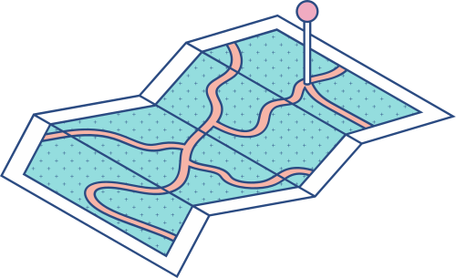





A Complete Guide To
Module 1: WEBSITE CREATION

Slide 2
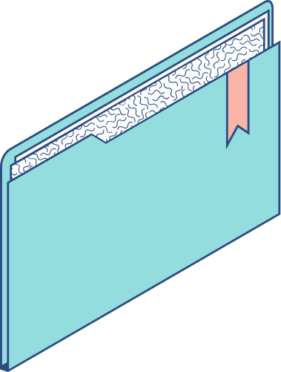
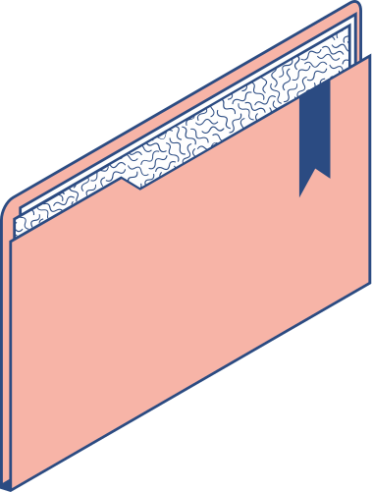

Agenda
KEY TOPICS DISCUSSED IN THIS PRESENTATION
Understanding the Website Importance
Understanding Website Basics
Website Creation Tools
Installing WordPress on Localhost using FlyWheel
Install WordPress on Localhost using XAMPP
Applying Security on Your Website Through Wordfence
Installling Other Plugins
Creating your Own Website

Slide 3

Localhost Practice Options
When you don’t have live hosting/domain:
Local by Flywheel (easiest)
XAMPP + WordPress manual install
Both let you spin up a Wordpress site entirely on your own computer before going live

Slide 4





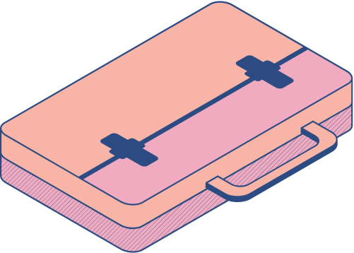
Installing WordPress on Localhost using FlyWheel

Slide 5
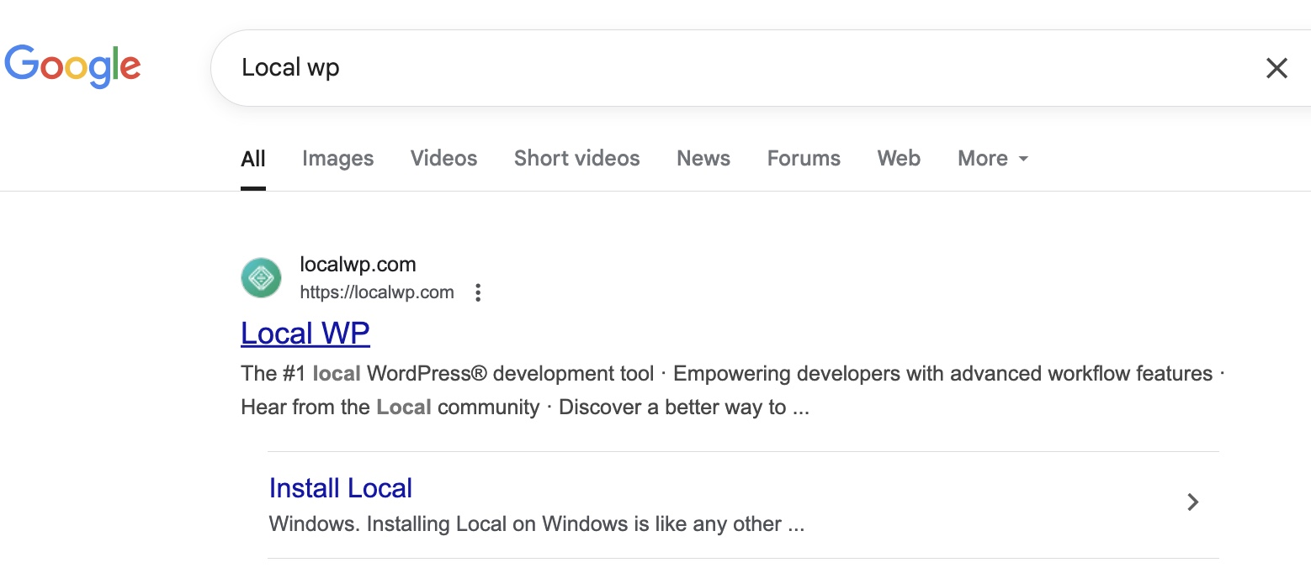
Step 1
Navigate to Local WP
Open your browser and search for Local WP
Click the LocalWP website link

Slide 6
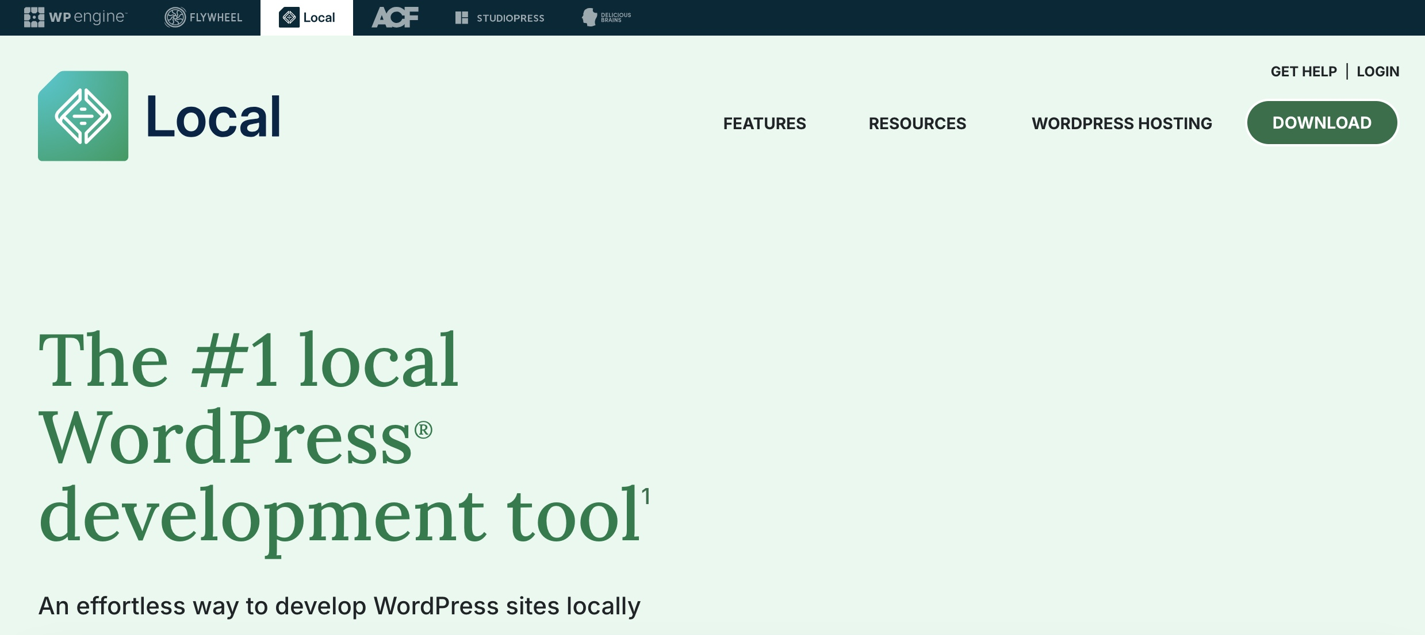
Step 2
Download Local
On the LocalWP homepage, click Download

Slide 7
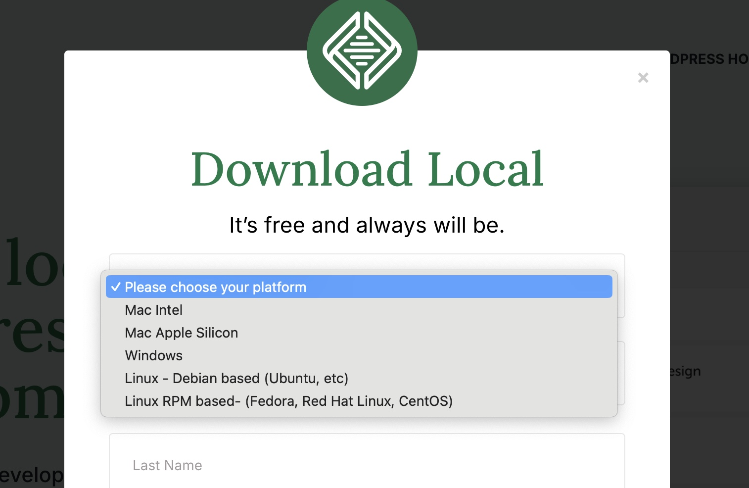
Step 3
Choose Platform
Select your operating system:
Windows
Mac

Slide 8
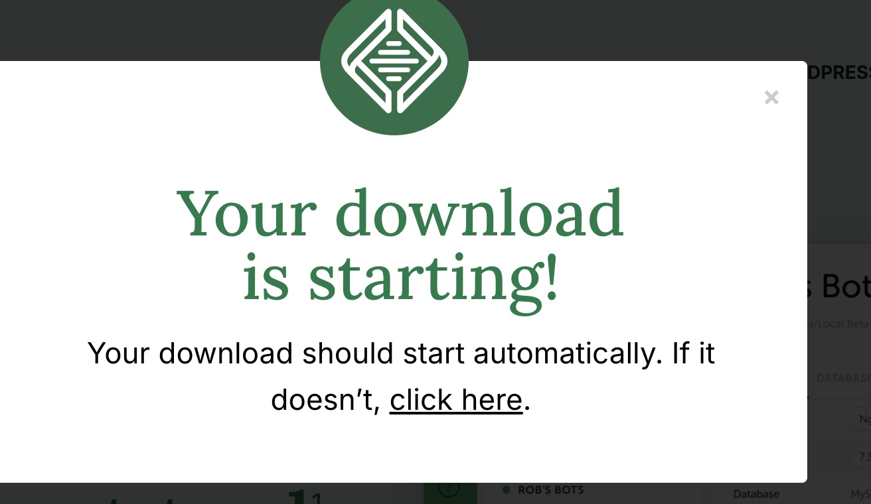
Step 4
Enter Details
Provide your Name and Email
Click Proceed to start downloading the installer

Slide 9
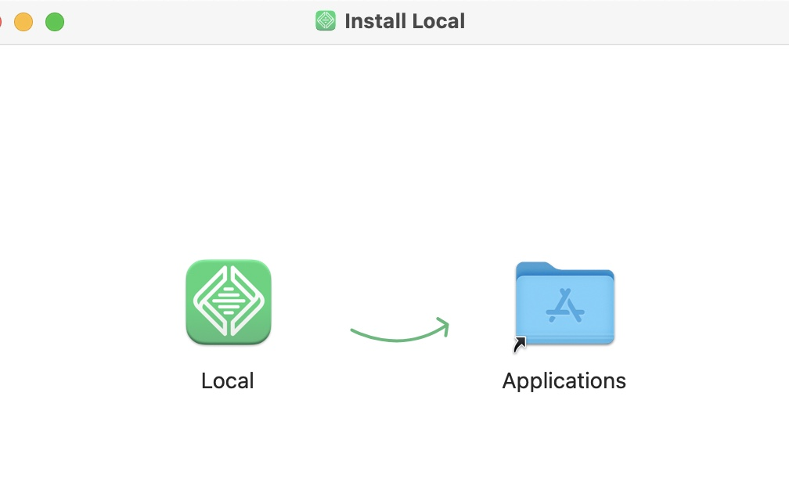
Step 5
Install Local
Open the downloaded installer file
Follow the on-screen instructions to install Local
When prompted, drag Local into your Applications folder

Slide 10
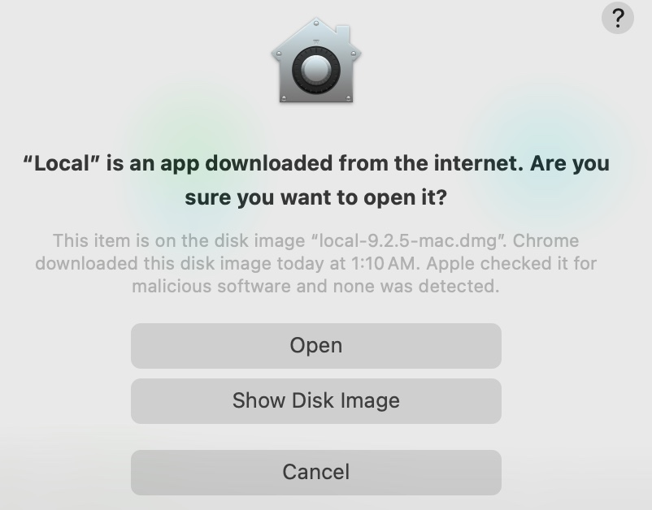
Step 6
Launch Local
Click the Local icon to launch the app
When asked, click Open to allow the application to run

Slide 11
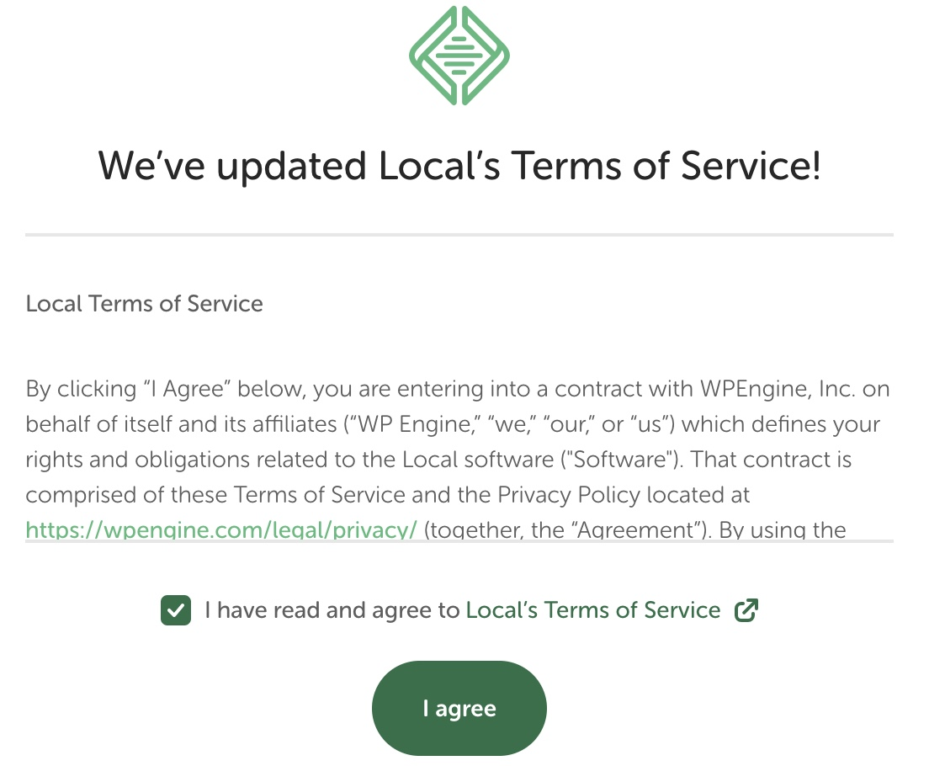
Step 7
Accept Terms
Read and Agree to the LocalWP Terms and Conditions

Slide 12
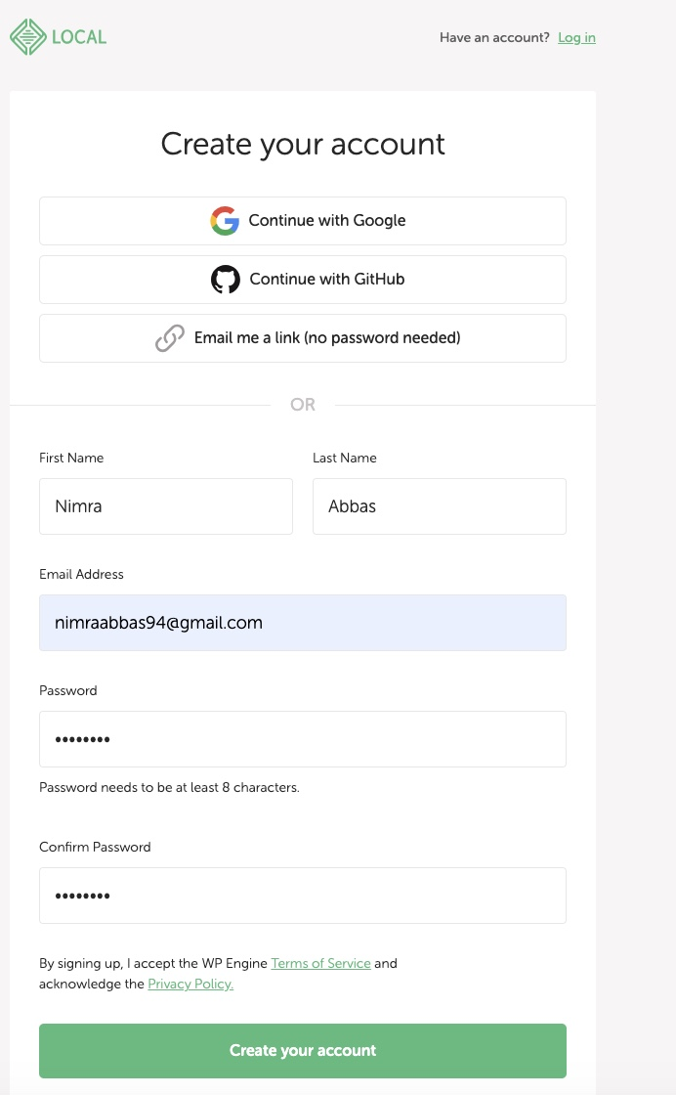
Step 8
Create Account
Select Create a free account
Fill in your details and submit

Slide 13
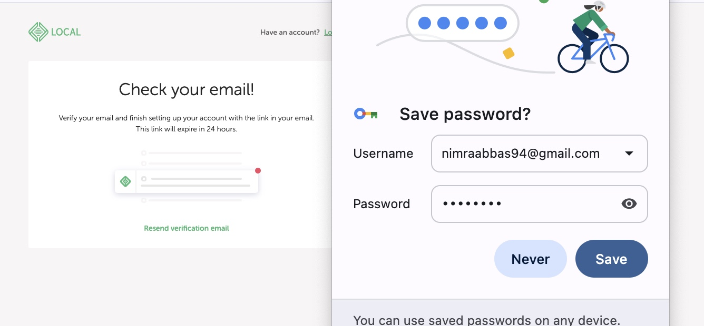
Step 9
Email Verification
Check your email and click the verification link
Once verified, return to LocalWP and log in with your credentials

Slide 14
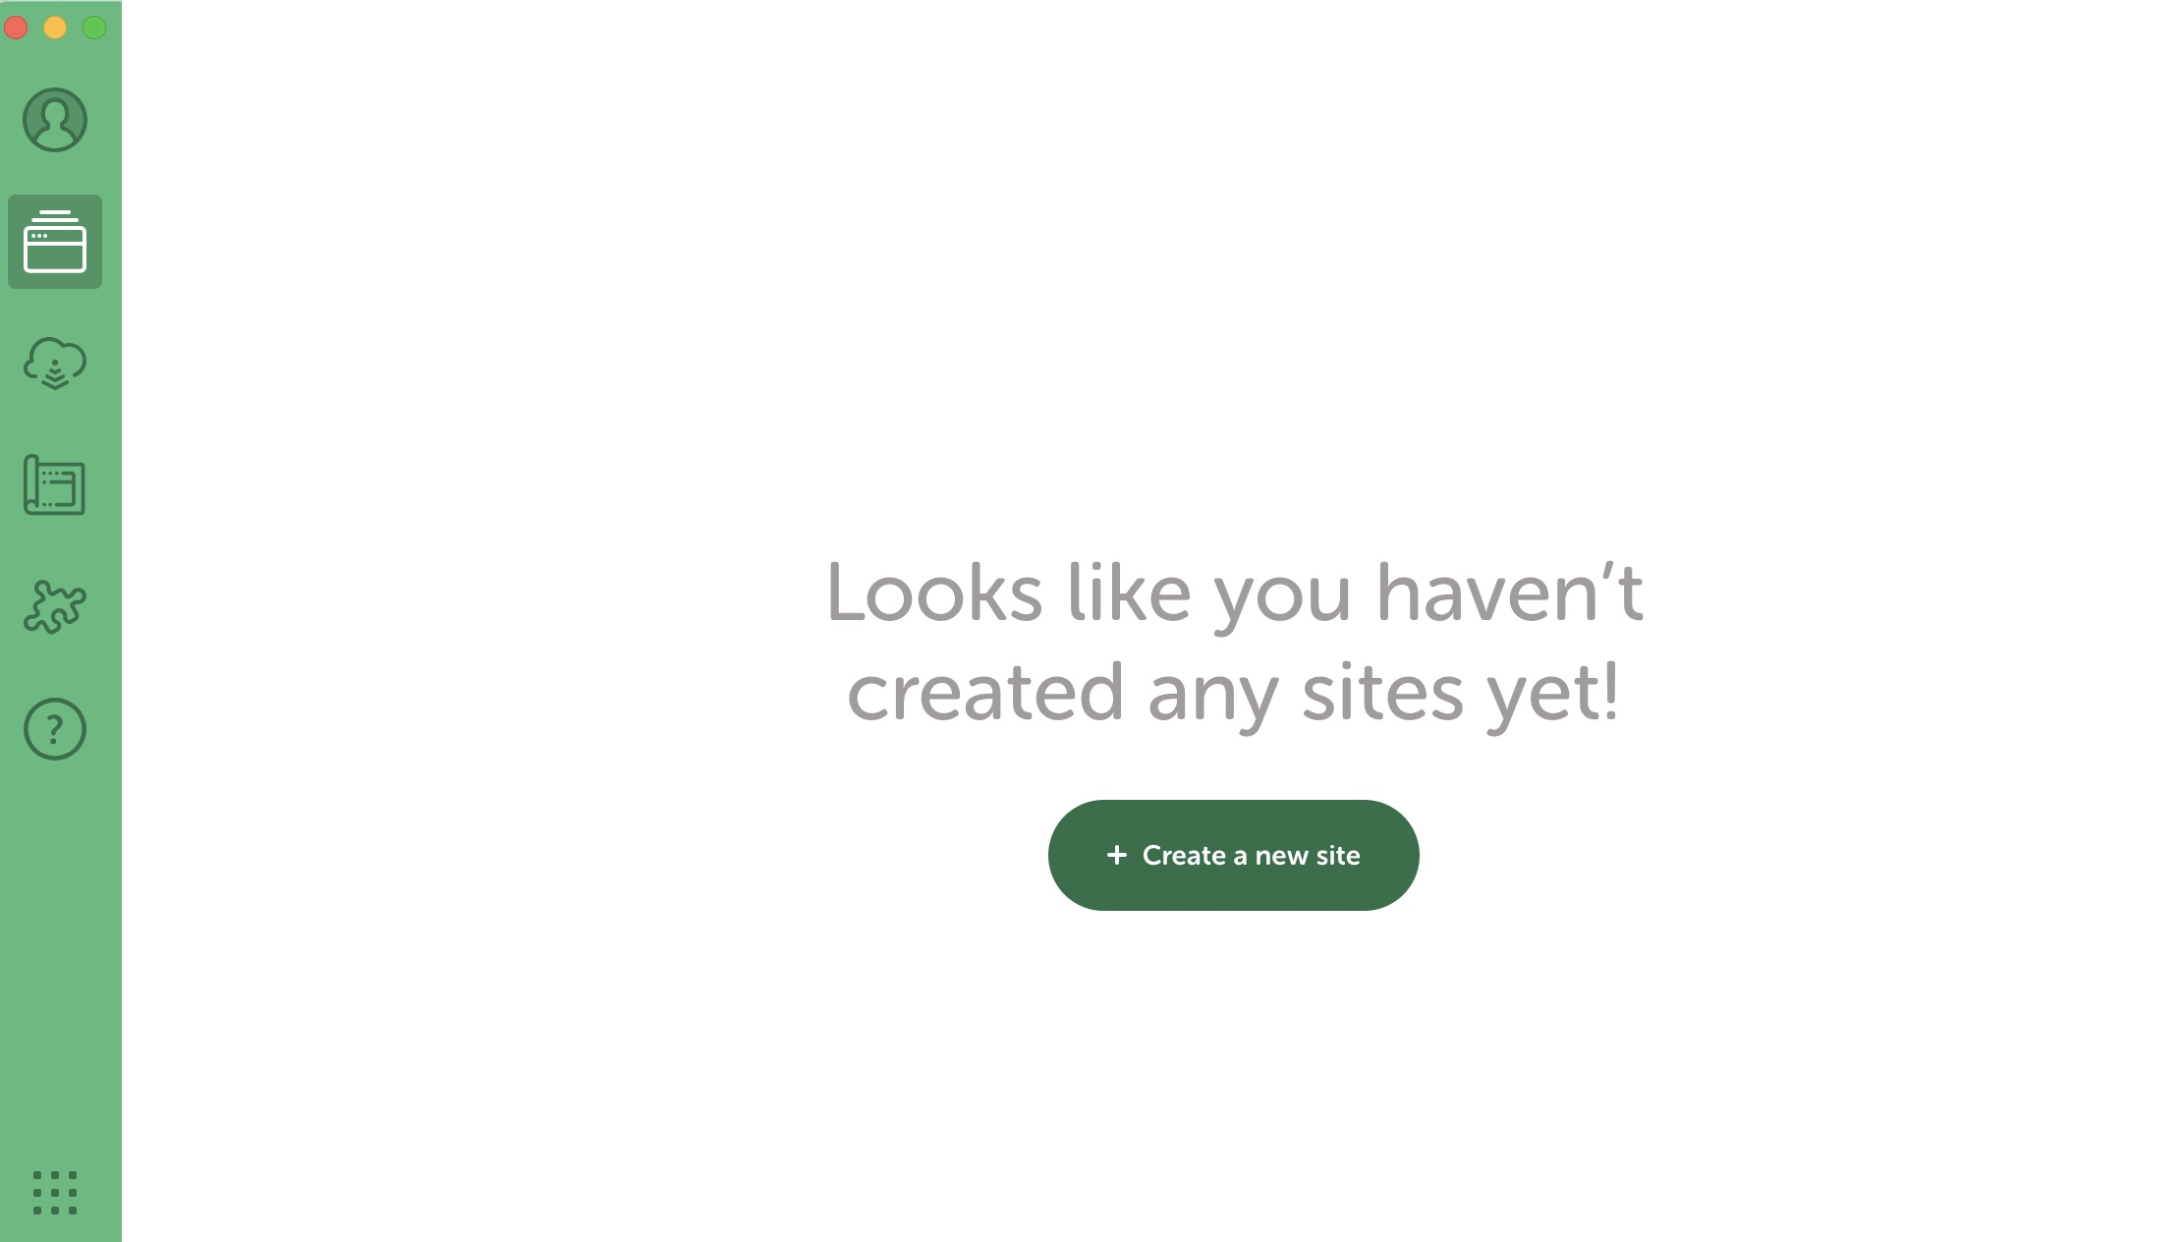
Step 10
LocalWP Dashboard
Upon login, you’ll see the LocalWP overview page
Your LocalWP app shows site folders, database, and tools
Click Create a new site

Slide 15
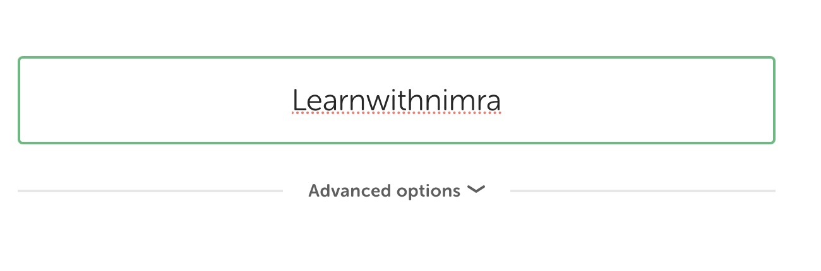
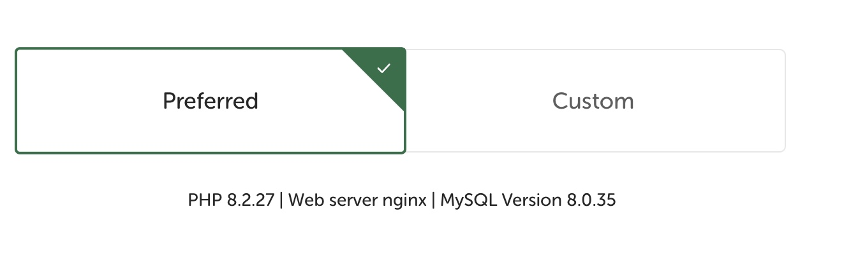
Step 11
Site Name
Enter a Site Name (any of your choice)
Click Continue
Choose Preferred environment

Slide 16
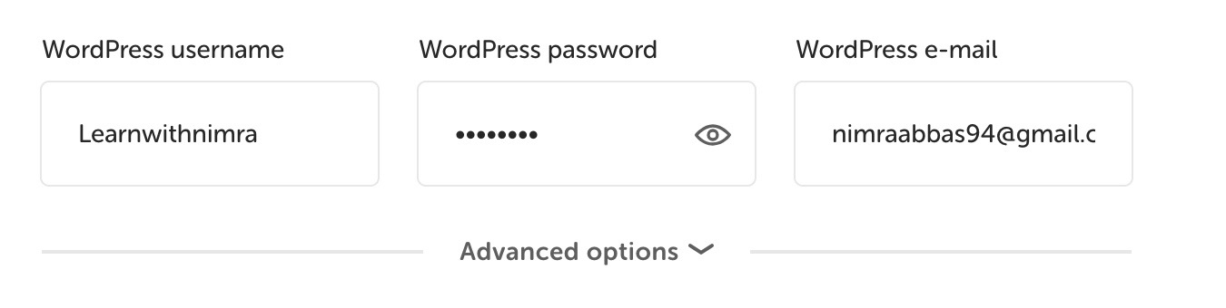
Step 12
WordPress Setup
Enter WordPress Username, Password, and Email
Click Continue

Slide 17
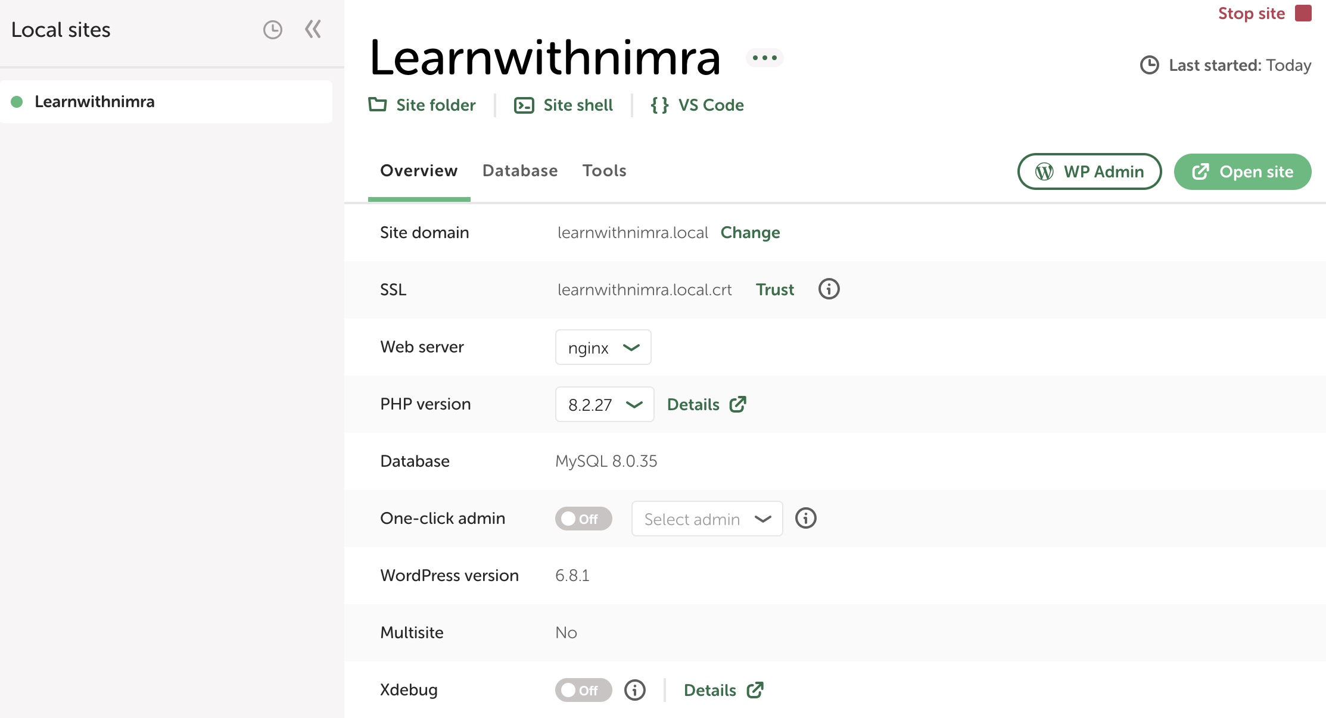
Step 13
Download & Setup
Local will automatically download and configure WordPress
Click Open Site to view your new WordPress installation in the browser
Keep LocalWP running in the background while you work on localhost

Slide 18
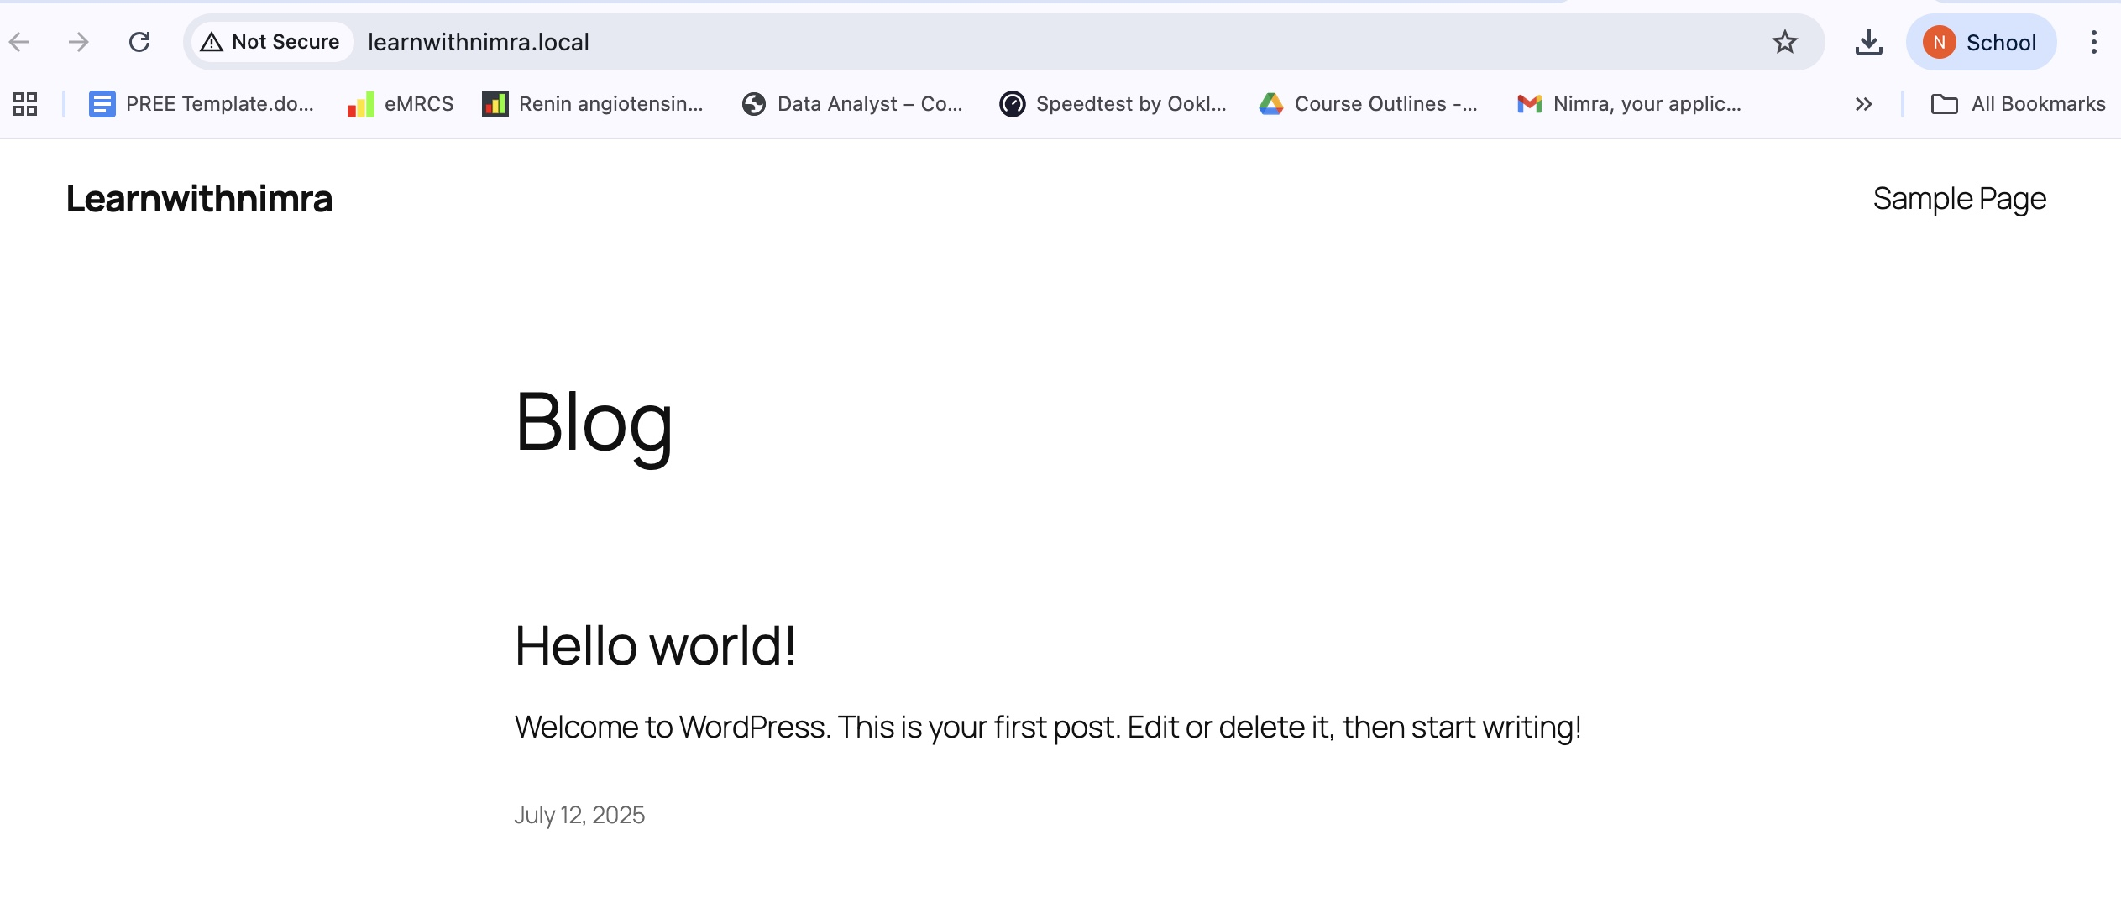
Site will Open

Slide 19
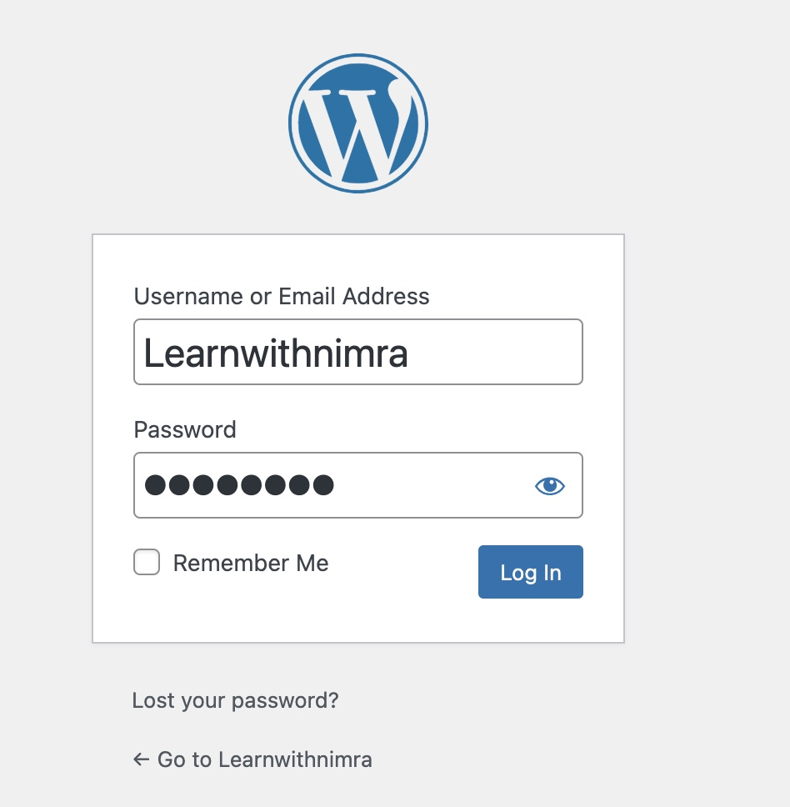
Step 14
Access WP‑Admin
Click WP Admin in LocalWP
Log in with the credentials you set earlier

Slide 20
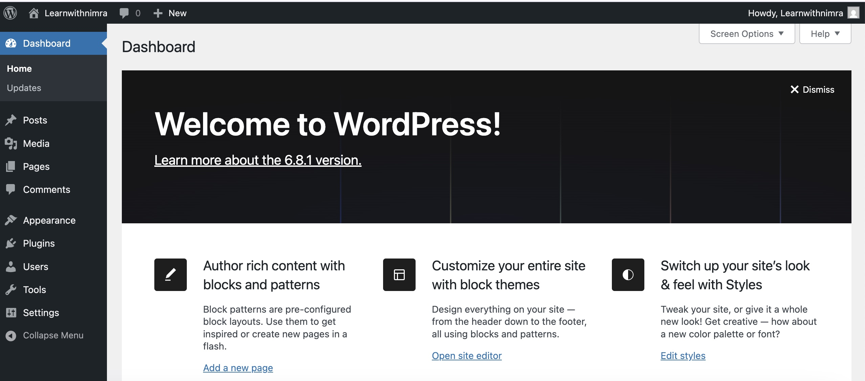
Step 15
WP Dashboard
After logging in, you’ll see the WordPress Dashboard

Slide 21
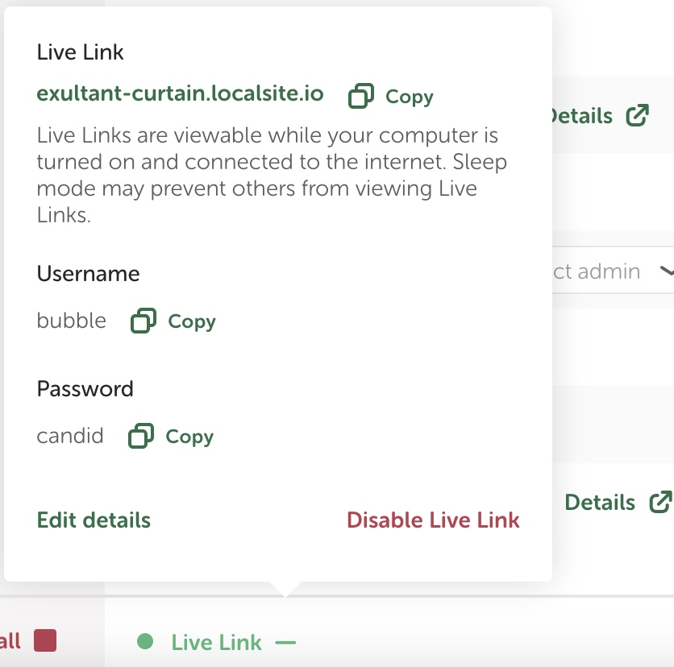
Step 16
Enable Live Link
In LocalWP, toggle Live Link to generate a public URL
Copy the link and credentials displayed

Slide 22
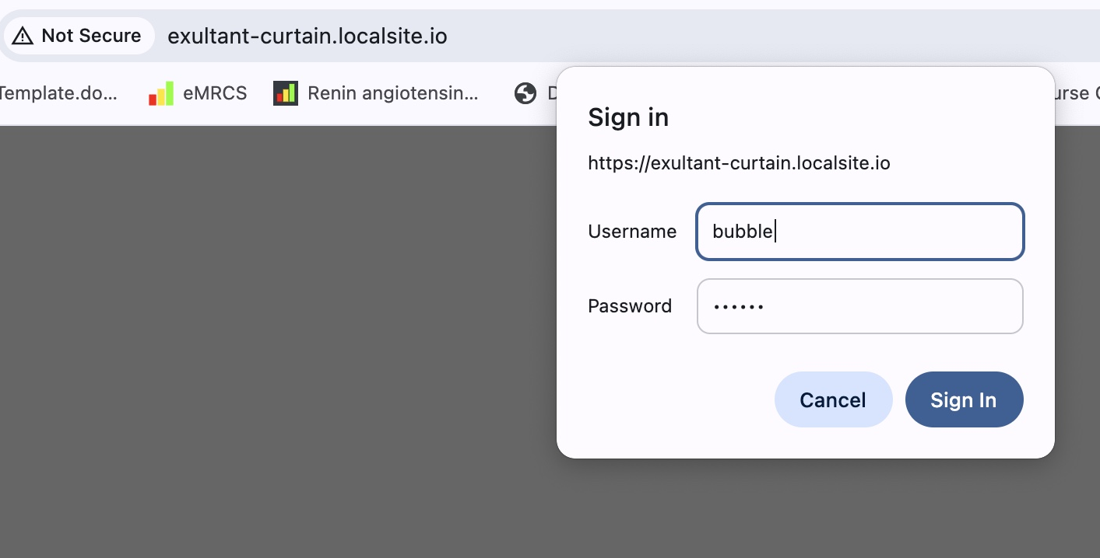
Step 17
Access Live Site
Paste the Live Link into your browser
Enter the WordPress credentials when prompted

Slide 23
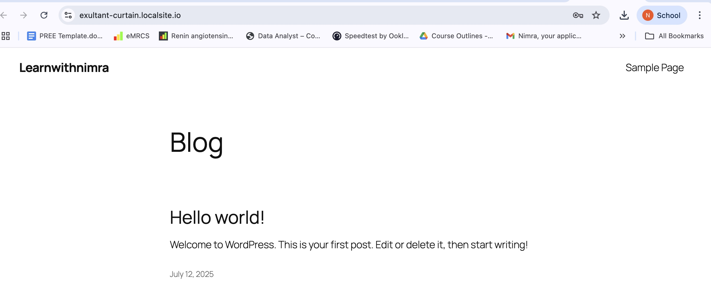
Site will open this way too

Slide 24
Install WordPress on Localhost using XAMPP

Slide 25
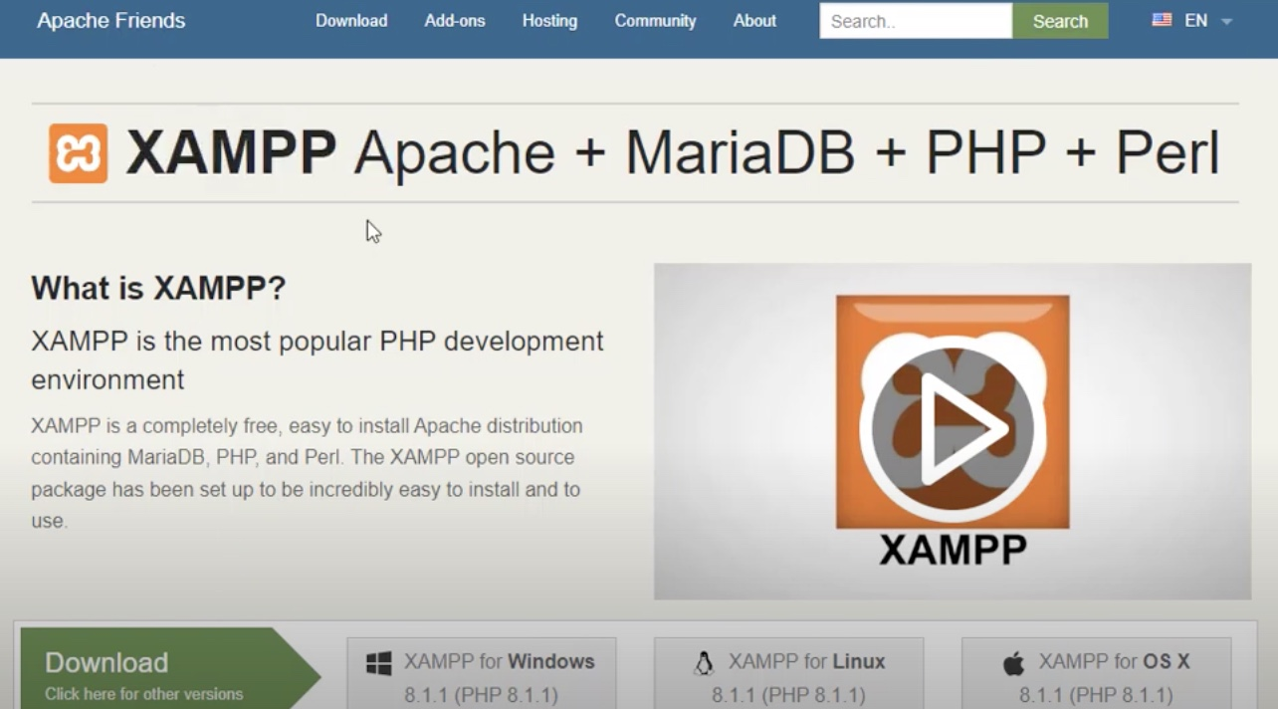
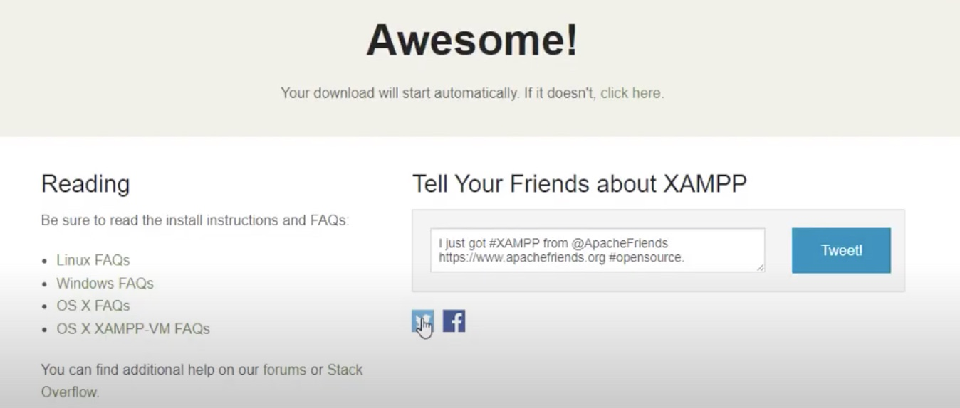
Step 1
Download XAMPP
Open your browser and go to apachefriends.org
Click Download XAMPP for your OS (Windows/Mac/Linux)

Slide 26
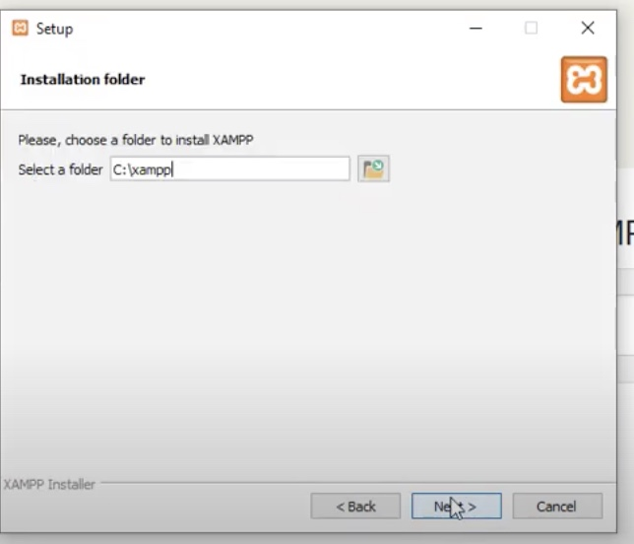
Step 2
Install XAMPP
Run the downloaded XAMPP installer.
Click Next through the prompts.
By default, XAMPP installs to C:\xampp (Windows) or /Applications/MAMP (Mac).

Slide 27
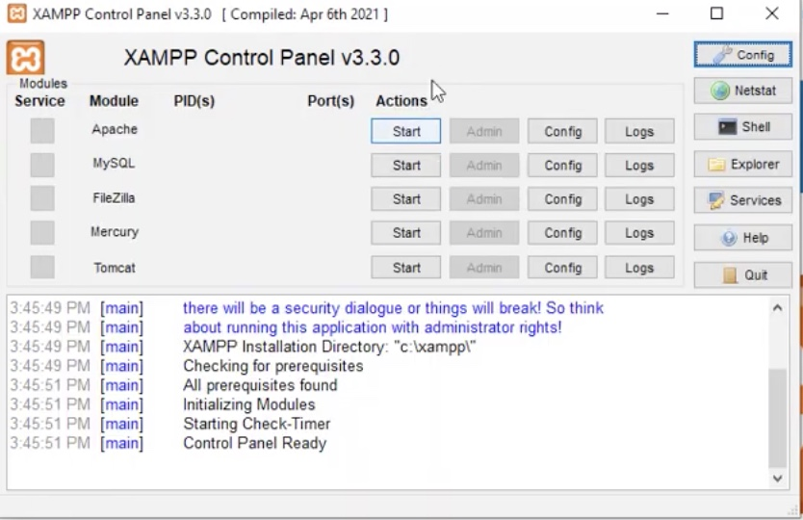
Step 3
XAMPP Control Panel
Launch XAMPP; you’ll see the Control Panel
The panel shows modules: Apache, MySQL, etc

Slide 28
Step 4
In your browser, go to wordpress.org, Click on “Get WordPress” and Download it
Extract the downloaded .zip file
Navigate to *C:\xampp\htdocs and create a folder with a name of your choice (e.g., Learnwithnimra)
Copy the wordpress folder files and paste it in “Learnwithnimra” folder
Download WordPress AND Extract

Slide 29
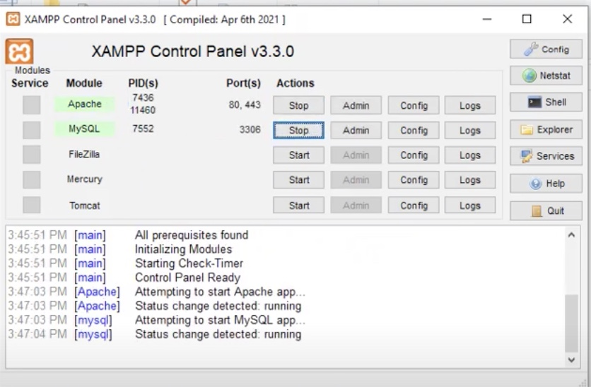
Step 5
Start Apache & MySQL
In XAMPP Control Panel, click Start next to Apache and MySQL
Ensure both modules show Running in green

Slide 30
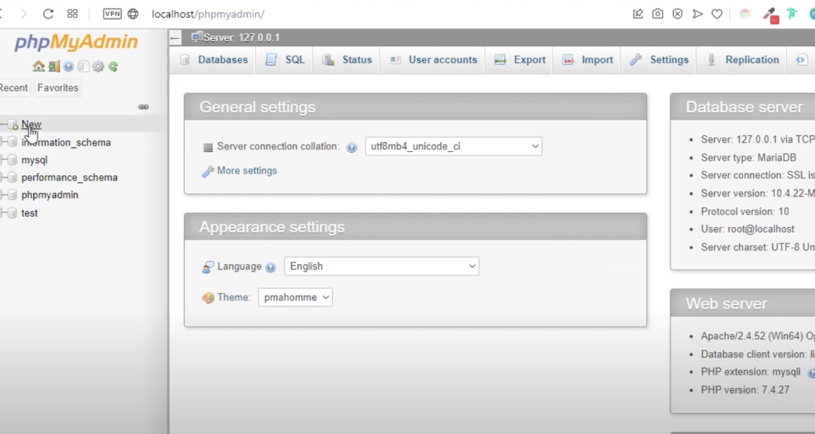
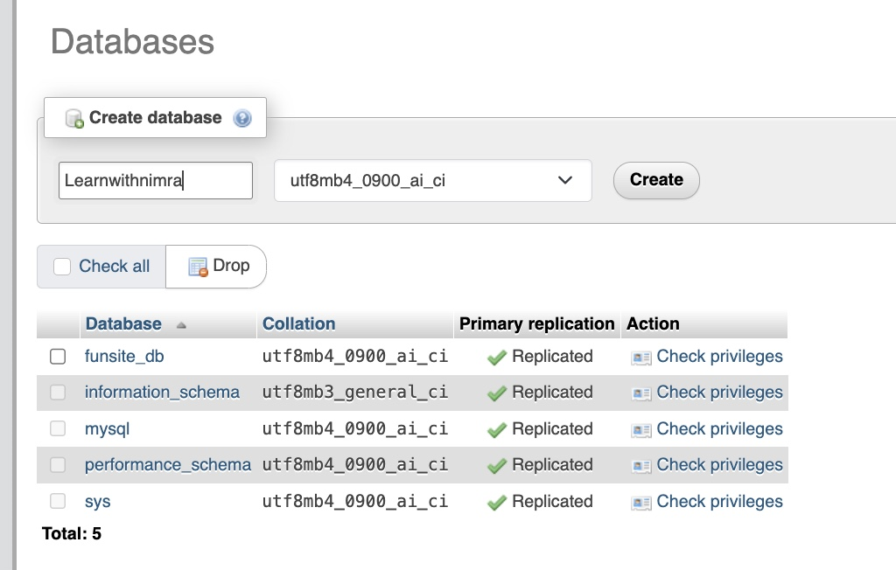
Step 6
Open phpMyAdmin
In your browser, go to “localhost/phpmyadmin” and the phpMyAdmin dashboard appears
Click New in phpMyAdmin
Enter Database name matching your folder (e.g., Learnwithnimra)
Click Create

Slide 31
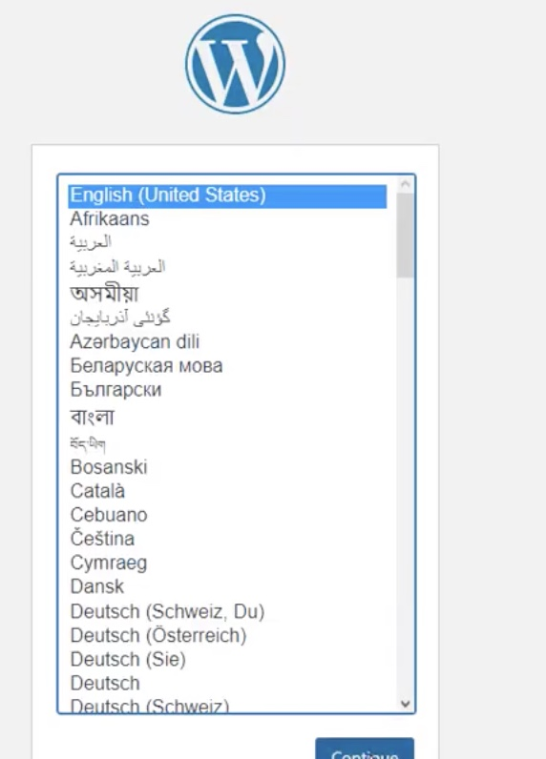
Step 7
Run WordPress Installer
Go to localhost/Learnwithnimra in your browser
Select English and click Continue
Click Let’s go!

Slide 32
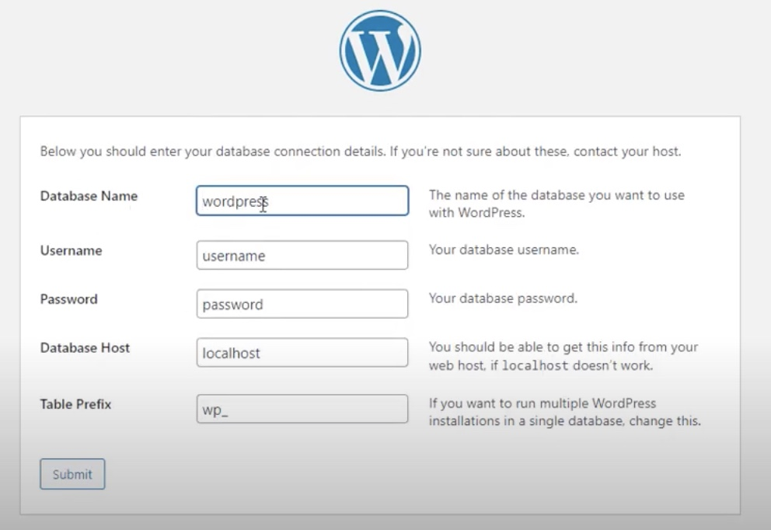
Step 8
Database Connection
Enter the following:
Database Name: Learnwithnimra
Username: root
Password: (leave blank)
Database Host: localhost
Table Prefix: wp_
2. Click Submit

Slide 33
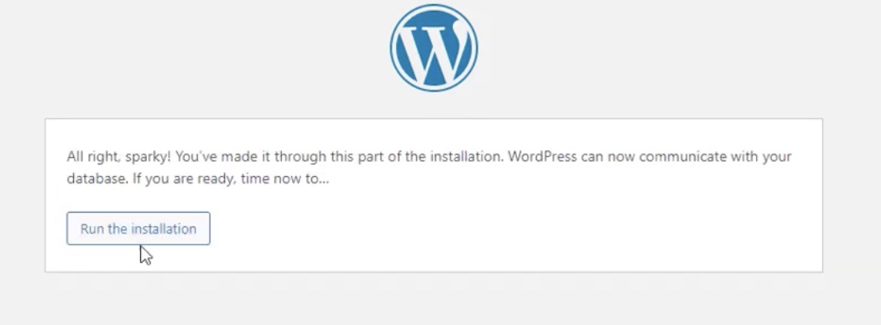
Step 9
Install WordPress
Once you click on submit, the following page will open
Click on, “Run the Installation”

Slide 34
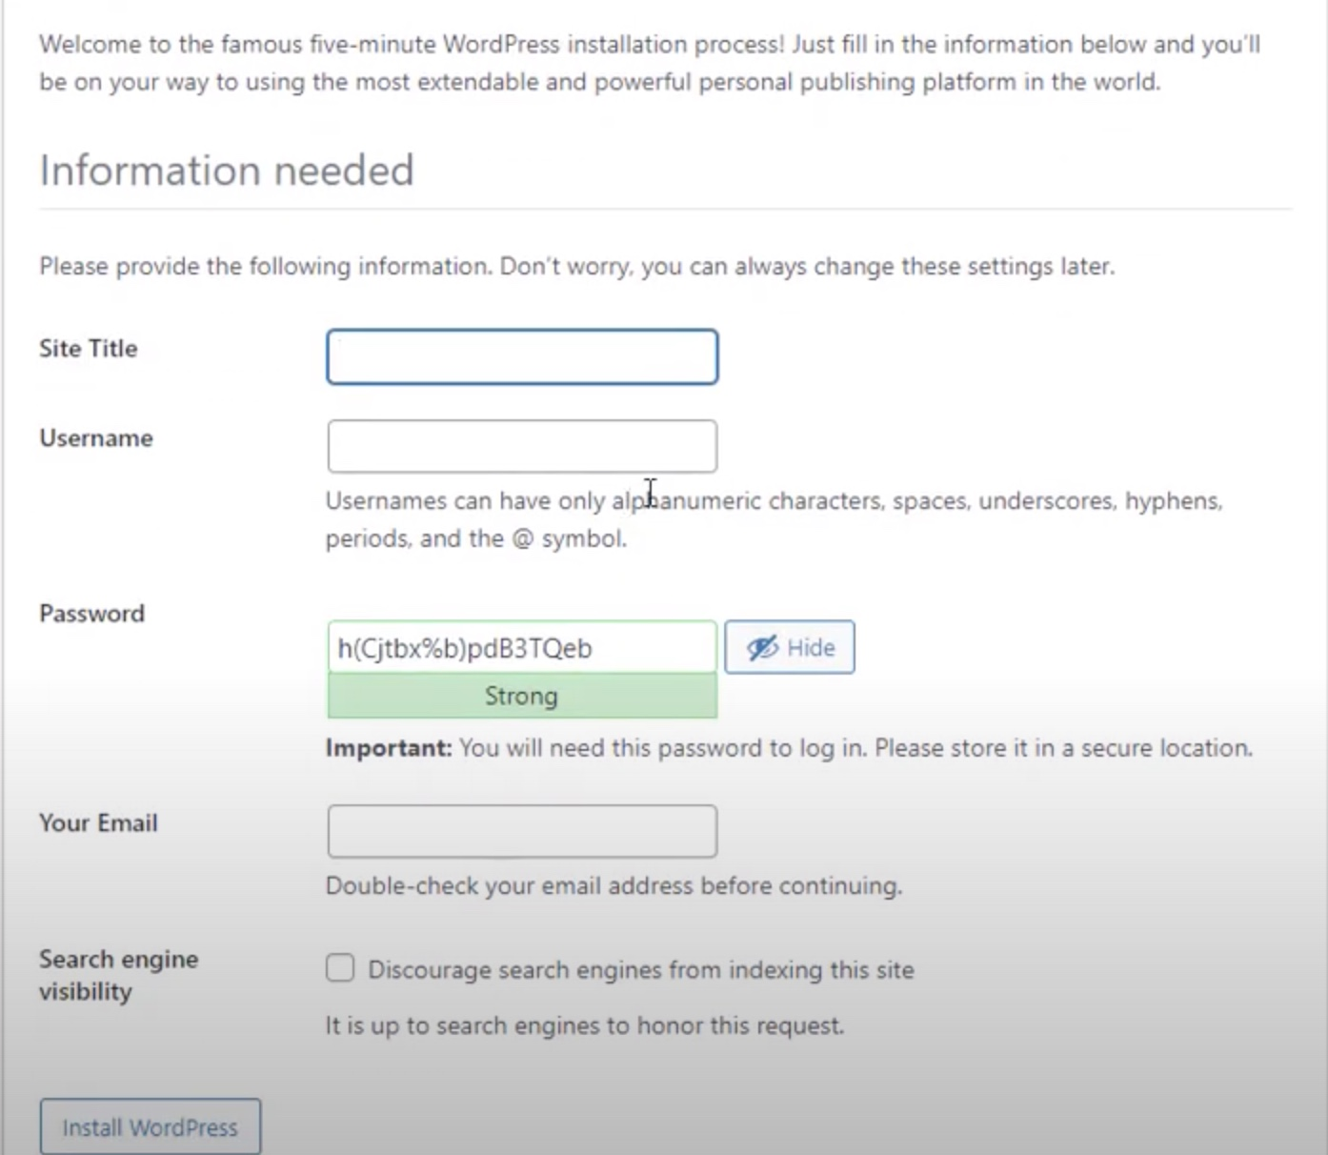
Step 10
Fill up all the Details
Fill in:
Site Title
Username (e.g., admin)
Password
Your Email
2. Click Install WordPress

Slide 35
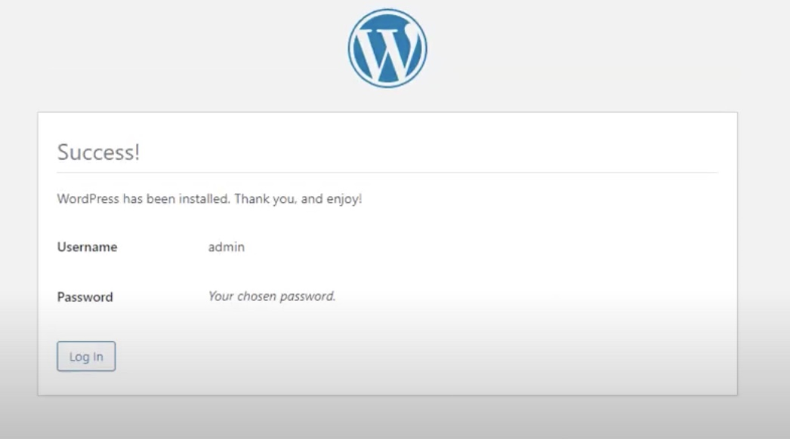
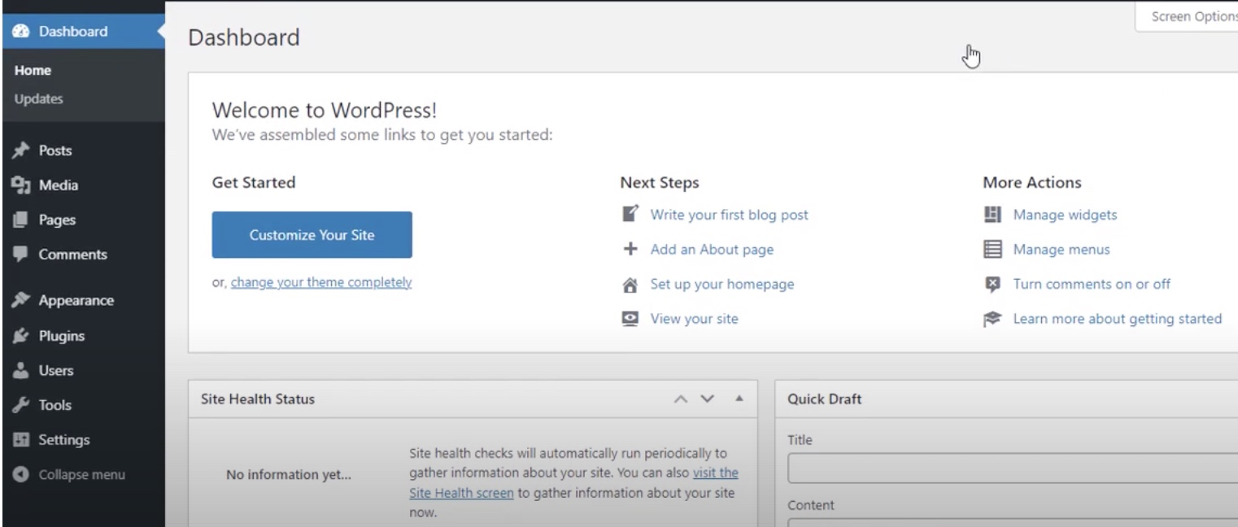
Step 11
Login to Dashboard
After installation, click Log In
Enter your WordPress Username and Password
The WordPress Dashboard opens

Slide 36
Step 11
Login to Dashboard
After installation, click Log In
Enter your WordPress Username and Password
The WordPress Dashboard opens

Slide 37
Site will open

Slide 38

“We’ve now explored two methods for running WordPress locally—using Local by Flywheel and XAMPP. It’s time to dive into WordPress itself : pick a theme, explore its features, and start customizing to make it your own!”

Slide 39

End of Lecture

